Slide 1


CYCLISTIC BIKE-SHARE ANALYSIS
CREATED BY – KUNAL TEWARI
DATED – 10 MAY 2023
SOURCE OF DATA – GITHUB

Slide 2
CYCLISTIC BIKE-SHARE ANALYSIS
CREATED BY – KUNAL TEWARI
DATED – 10 MAY 2023
SOURCE OF DATA – GITHUB

Slide 3

ABOUT CYCLISTIC
CREATED BY – KUNAL TEWARI
DATED – 10 MAY 2023
SOURCE OF DATA – GITHUB
Cyclistic is a bike sharing company.
Cyclistic has segregated their customers into 2 types – ‘Members’ and ‘Casuals’.
Members are the ones who have memberships for year round. Members are much more profitable for the company than casual users.

Slide 4
BUSINESS OBJECTIVE
Understanding the difference between ‘Casual users’ and ‘Members’ using Cyclistic.
How can we convert the ‘Casuals’ into ‘Members’

Slide 5
install.packages("tidyverse")
library(tidyverse)
#Loading data -----
d1 <- read_csv("2022 Apr.csv")
head(d1)
#installing dplyr for data manipulation -----
library(dplyr)
library(lubridate)
#Transformation of data into insights -----
transformed_data <- d1 %>% select (rideable_type, started_at, ended_at, member_casual) %>% mutate (ride_length = difftime( ended_at, started_at, units ='mins'), start_day = weekdays(started_at), ride_length_int = round(ride_length), start_date = as.Date(started_at) )
#check if ride length is 0 or less than 0
transformed_data %>% filter(ride_length_int <= 0) %>% count()
# 3493 zero minutes and 1 negative values , therefore removing these values.
clean_data <- transformed_data %>% filter(ride_length_int > 0)count(clean_data)
#check for unique entities in rideable_type
unique (transformed_data$rideable_type)
# 3 types - classic, electric and docked
summary(clean_data)
#Now, we plot the data -----
library(ggplot2)
#1- First plot, we understand the difference in the members and casuals.
ggplot(data= clean_data) + geom_bar(mapping=aes(x = member_casual), fill="coral") + theme_classic()+ labs(title = "Retained customers", x= "Casuals and Members")
#2- Total usage of type of bikes for members/casuals.
ggplot(data= clean_data) + geom_bar(mapping=aes(x=rideable_type, fill = member_casual)) + labs(x="type of bike", y= "total usage for members and casuals")
#3- For order the days
clean_data$start_day <- factor(clean_data$start_day, c("Monday", "Tuesday", "Wednesday", "Thursday","Friday","Saturday", "Sunday"))
#Weekly usage of bikes by members/casuals
ggplot(data= clean_data, mapping=aes(x=start_day, fill = member_casual)) + geom_bar(position= position_dodge()) + labs(x="weekdays",y="Users", title= "Weekly bike users", subtitle ="Difference in weekly bike usage - members and casuals")
ggplot(data= clean_data, mapping=aes(x=start_day, fill =rideable_type)) + geom_bar(position= position_dodge()) + labs(x="weekdays",y="Bikes used", title= "Weekly bikes users", subtitle ="Difference in weekly bike used by members and casuals")
-----
Code
(for the boring ones)

Slide 6
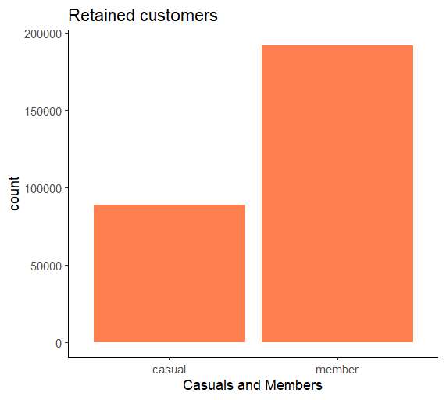
Analysis and findings
A
B
C

Slide 7
A
B
C
Analysis and findings
#From the 1st graph, we understand that the company has 88,814 users, which are currently Casuals and can be converted to Members.
#Currently the company has 1,91,834 Members.

Slide 8
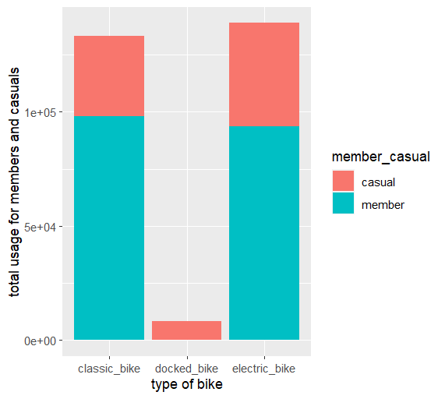
B
C
A
#From the 2nd graph we note the difference in total usage of types of bikes.
#Docked bikes are currently not being used by the Members. Hence, this could be a potential target for the sales team to target for casuals.
#From the 1st graph, we understand that the company has 88,814 users, which are currently Casuals and can be converted to Members.
#Currently the company has 1,91,834 Members.

Slide 9
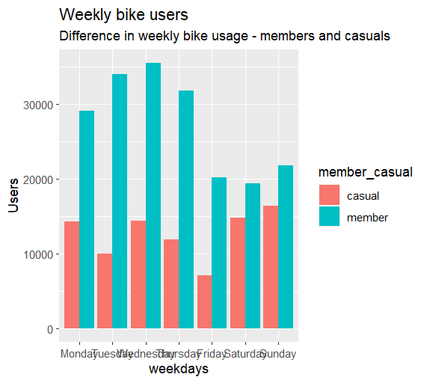
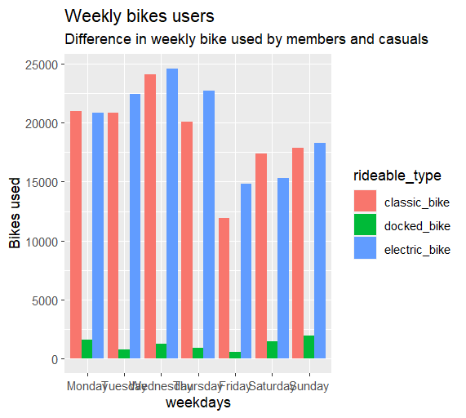
A
C
B
#3rd graph has 2 graphs ---
#1st represents the members and casuals using bikes weekly, where the casuals are seen to use bikes more on weekends and exactly opposite for the members.
#2nd graph indicates that the electric bikes are most used. It also resurfaces the theory of 2nd graph, by giving us the insight of more usage of docked bikes in the weekends.
#From the 2nd graph we note the difference in total usage of types of bikes.
#Docked bikes are currently not being used by the Members. Hence, this could be a potential target for the sales team to target for casuals.
#From the 1st graph, we understand that the company has 88,814 users, which are currently Casuals and can be converted to Members.
#Currently the company has 1,91,834 Members.

Slide 10
A
B
C
#3rd graph has 2 graphs ---
#1st represents the members and casuals using bikes weekly, where the casuals are seen to use bikes more on weekends and exactly opposite for the members.
#2nd graph indicates that the electric bikes are most used. It also resurfaces the theory of 2nd graph, by giving us the insight of more usage of docked bikes in the weekends.
#From the 2nd graph we note the difference in total usage of types of bikes.
#Docked bikes are currently not being used by the Members. Hence, this could be a potential target for the sales team to target for casuals.

Slide 11
A
B
C
Insights
#3rd graph has 2 graphs ---
#1st represents the members and casuals using bikes weekly, where the casuals are seen to use bikes more on weekends and exactly opposite for the members.
#2nd graph indicates that the electric bikes are most used. It also resurfaces the theory of 2nd graph, by giving us the insight of more usage of docked bikes in the weekends.

Slide 12
A
B
C
Insights
Suggestions
The company has 88,814 casual users.
Docked bikes are least used. However, they are only used by Casual Users.
Weekends and Mondays are prime time for casual users to hire a bike.
Docked bikes are mostly used on weekends and Mondays, which strengthens our theory of weekend casual riders.
Docked bikes could be a potential target for the sales team to target for casuals.
If docked bikes are found more profitable by casuals, number of docked can be increased with added benefits for memberships in weekends.
Linked benefits can be offered with memberships for those using bikes on weekends could help attract more memberships.

Slide 13
Insights
Suggestions
The company has 88,814 casual users.
Docked bikes are least used. However, they are only used by Casual Users.
Weekends and Mondays are prime time for casual users to hire a bike.
Docked bikes are mostly used on weekends and Mondays, which strengthens our theory of weekend casual riders.
Docked bikes could be a potential target for the sales team to target for casuals.
If docked bikes are found more profitable by casuals, number of docked can be increased with added benefits for memberships in weekends.
Linked benefits can be offered with memberships for those using bikes on weekends could help attract more memberships.

Slide 14
ANY QUESTIONS???
NO???

Slide 15

ANY QUESTIONS???
NO???
THANK YOU

Slide 16
THANK YOU
ANY QUESTIONS???
NO???

Slide 17
THANK YOU
ANY QUESTIONS???
NO???

